Slide 1



Restaurant Orders Data Analysis
Created by :
Bhagyashree Dahima

Slide 2

Objective 1Explore the items table
Your first objective is to better understand the items table by finding the number of rows in the table, the least and most expensive items, and the item prices within each category.

Slide 3

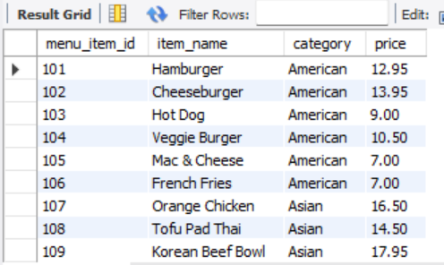
View the menu_items table and write a query to find the number of items on the menu

Slide 4


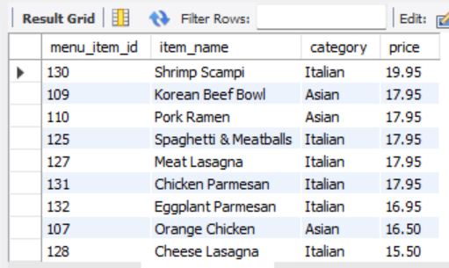


Slide 5


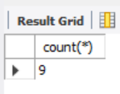

Slide 6




Slide 7


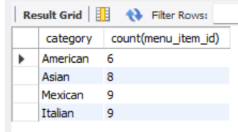

Slide 8


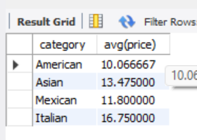


Slide 9
Objective 2Explore the orders table
Your second objective is to better understand the orders table by finding the date range, the number of items within each order, and the orders with the highest number of items.

Slide 10




Slide 11

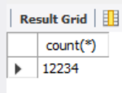


Slide 12

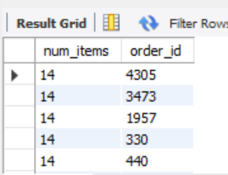

Slide 13

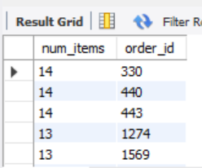

Slide 14
Objective 3Analyze customer behavior
Your final objective is to combine the items and orders tables, find the least and most ordered categories, and dive into the details of the highest spend orders.

Slide 15

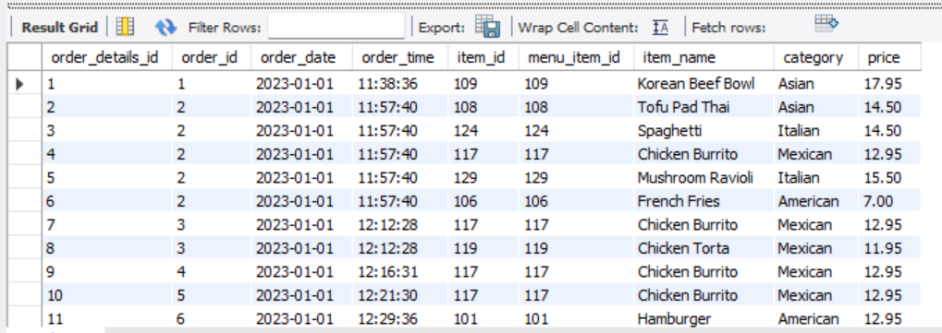

Slide 16

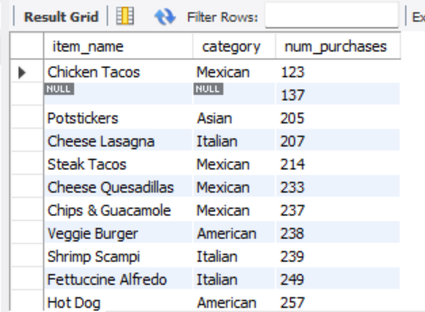

Slide 17
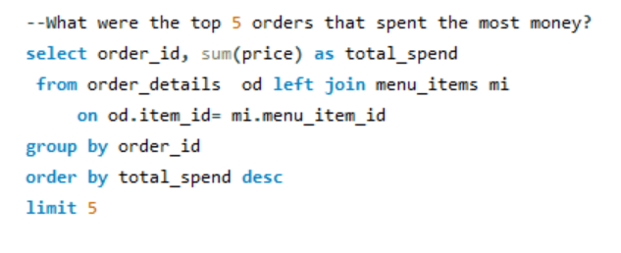

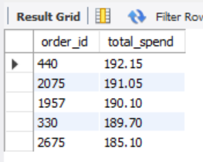

Slide 18

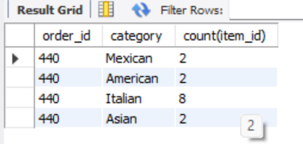

Slide 19
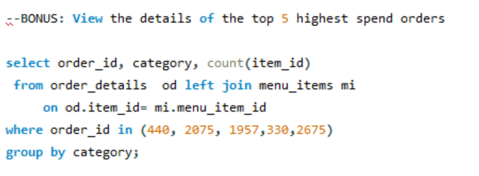

Slide 20

Thankyou

